Slide 1
Processing Stages in Data stage 8.7
Any use, copying or distribution without written permission from UnitedHealth Group is prohibited.

Slide 2
Sorting Data
Important because
  Some stages require sorted input
  Some stages may run faster – I.e Aggregator
Can be performed
  Option within stages (use input > partitioning tab and set partitioning to anything other than auto)
  As a separate stage (more complex sorts)

Slide 3

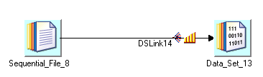
Sorting Alternatives
Alternative representation of same flow:
Notes:
One of the nation's largest direct marketing outfits has been using this simple program in DS-EE (and its previous instantiations) for years.
Householding yields enormous savings by avoiding mailing the same material (in particular expensive catalogs) to the same household.

Slide 4
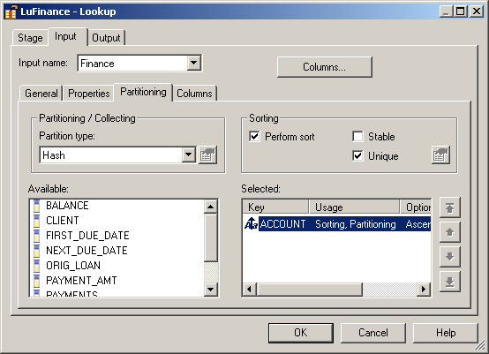
Sort Option on Stage Link
Notes:
Stable will not rearrange records that are already in a properly sorted data set. If set to false no prior ordering of records is guaranteed to be preserved by the sorting operation.

Slide 5
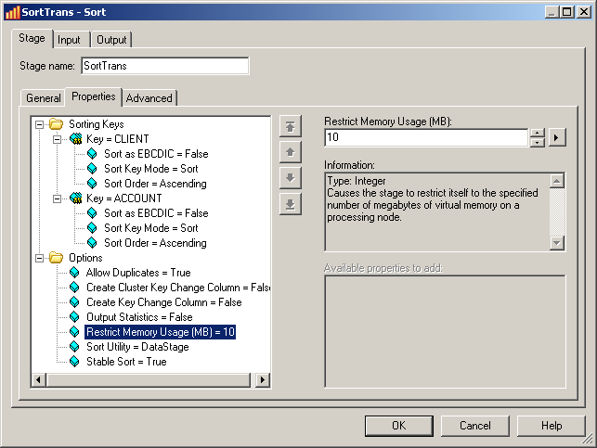
Sort Stage

Slide 6
Sort Utility
DataStage – the default
UNIX

Slide 7
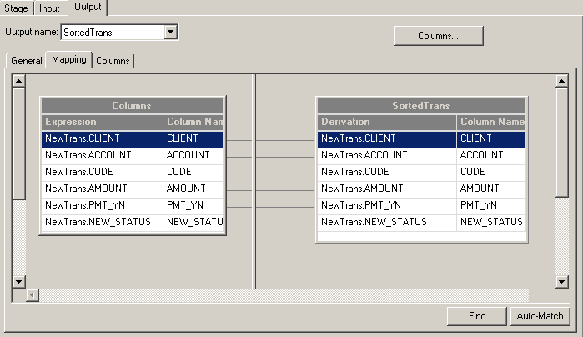
Sort Stage - Outputs
Specifies how the output is derived

Slide 8
Sort Specification Options
Input Link Property
  Limited functionality
  Max memory/partition is 20 MB, then spills to scratch
Sort Stage
  Tunable to use more memory before spilling to scratch.
Note: Spread I/O by adding more scratch file systems to each node of the APT_CONFIG_FILE

Slide 9

Remove Duplicates Stage :
Active/Processing stage with Single input link and single output link
Takes sorted input data as input and removes duplicate records
Operates both in sequential and parallel modes
Stage :
Any use, copying or distribution without written permission from UnitedHealth Group is prohibited.

Slide 10
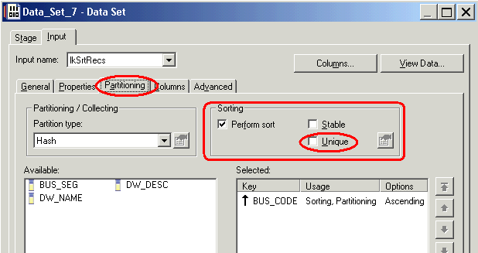
Remove Duplicates Stage :
Duplicate records are determined and removed based on the key fields mentioned
When running in parallel mode
  Duplicates are removed in partition (and not across partitions)
  Hash partition the input with the same fields mentioned as keys
Dupes can be also be removed using the Unique checkbox
Any use, copying or distribution without written permission from UnitedHealth Group is prohibited.

Slide 11
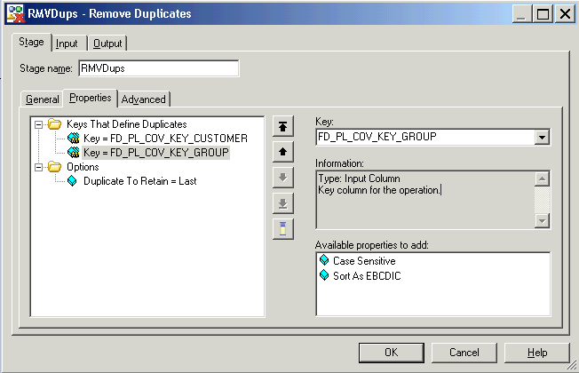
Remove Duplicates Stage : Properties
Key fields based on which duplicates will be removed – Repeatable property
the Only option available
Properties available for key fields
Any use, copying or distribution without written permission from UnitedHealth Group is prohibited.

Slide 12
Removing Duplicates
Can be done by Sort stage
  Use unique option
  OR
Remove Duplicates stage
  Has more sophisticated ways to remove duplicates

Slide 13
Aggregator Stage :
Active/Processing stage with Single input link and single output link
Groups input data rows on specified grouping keys/fields and computes counts or other aggregate functions for each group
You can specify zero or more grouping key fields
Output records contain a field for every grouping key, and a field for every summary field added by the operator.
Operates both in sequential and parallel modes
Two methods of Grouping : Hash and Sort
Uses Orchestrate Operators : group/statistics
Any use, copying or distribution without written permission from UnitedHealth Group is prohibited.

Slide 14
Aggregator Stage : Aggregation Types
Available types of aggregation :
  Count Rows :
    Counts the number of rows within each group ( set of records having same values for the specified grouping fields )
    We have to specify the output column name which holds the count
  Calculation (Default Type) :
    Summarizes on specified column(s) for each group based on grouping keys, can specify multiple columns for calculation
    By default all calculation columns have an output type of double.
    ‘Decimal Output’ : property allows you to specify that the calculation column has an output type of decimal
    Operations available : sum, mean, variance, standard deviation etc.,
Any use, copying or distribution without written permission from UnitedHealth Group is prohibited.
Notes:
Weighting column
Configures the stage to increment the count for the group by the
contents of the weight column for each record in the group, instead of
by 1. Not available for Summary Column for Recalculation. Setting
this option affects only the following options:
􀂄 Percent Coefficient of Variation
􀂄 Mean Value
􀂄 Sum
􀂄 Sum of Weights
􀂄 Uncorrected Sum of Squares

Slide 15
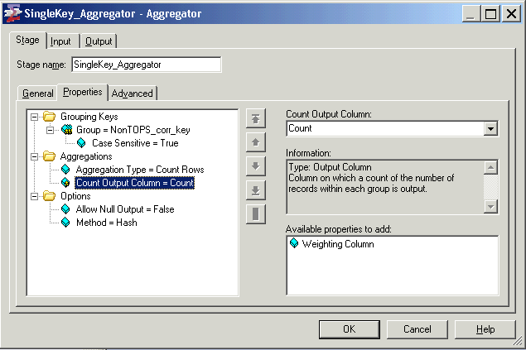
Aggregator Stage : Properties
Aggregation Type : Count Rows
All available properties shown for grouping type : Count Rows
Can specify multiple grouping keys
Have to mention the name of the output field which should contain the count
Any use, copying or distribution without written permission from UnitedHealth Group is prohibited.
Notes:
By default the aggregator stage would create the output counted field as double
This Aggregation type simply gives the number of rows in each of the group (grouping is done based on the Grouping Keys specified)

Slide 16
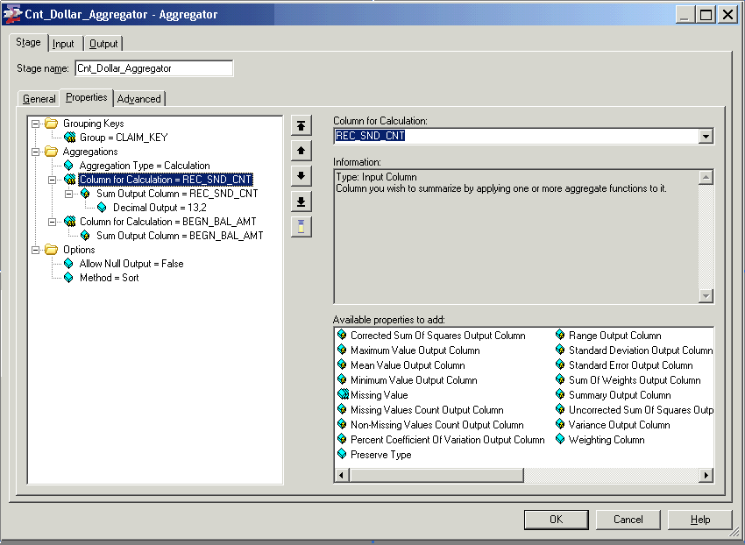
Aggregator Stage : Properties
Aggregation Type : Calculation
By default output type of the calculated field will be double. That can be overridden using this property
All the available calculation operations
Grouping Method : sort
Aggregator expects input data to be sorted on the grouping keys
Any use, copying or distribution without written permission from UnitedHealth Group is prohibited.

Slide 17
Aggregator Stage : Grouping Methods
Sort and Hash are the two grouping methods available, choice depends on number of distinct groups in input and memory available.
Hash (Default Method) :
  Input data should be hash partitioned on one or more of grouping fields
  Running summaries for each group are maintained as in-memory hash tables
  Final results are written out only when all input records have been processed
  Works efficiently when the distinct number of groups is small
Sort :
  Requires input data to be sorted on all the grouping keys
  At any point of time, only one groups running summary is maintained in-memory
  Results are written out whenever a new group is encountered
Sort method works more efficiently than hash when there are more number of grouping keys used/ the number of distinct groups are more.
Any use, copying or distribution without written permission from UnitedHealth Group is prohibited.
Notes:
You typically use hash mode
for a relatively small number of groups; generally, fewer than about 1000 groups per megabyte of memory to be used
Input data should be hash partitioned by one or more of grouping field
Any other partitioning method can be used if keeping group records in the same partition is not necessary
sort mode requires the input data set to have been partition
sorted with all of the grouping keys specified as hashing and sorting keys.

Slide 18
Aggregator Stage : More…
Caution
  When aggregating data (using most of the grouping operations) it is important that all the records pertaining to a single grouping key combination are present in the same partition
    ex: calculating total salary received in a year for an employee, considering EMPID and YEAR to be grouping keys all records pertaining to the key combination should be in a same partition otherwise we will end up having multiple summaries for each EMPID , YEAR combination
When using aggregator with Sort method operating in Sequential mode, use the ‘sortmerge’ collector as collection method
It is not mandatory to use hash partitioning with Hash Method if keeping groups together in a single partition is not important.
  ex: If you are doing an incremental aggregation i.e, summing records in
  each partition and later adding the sums across all partitions
Use hash mode for a relatively small number of groups; generally, fewer than about 1000 groups per megabyte of memory to be used.
Any use, copying or distribution without written permission from UnitedHealth Group is prohibited.

Slide 19
Module : Modify Stage

Slide 20
Module Objectives
At the end of this module you will be able to:
  Use the Modify Stage to alter input schema
  Describe the different properties available with Modify stage
Any use, copying or distribution without written permission from UnitedHealth Group is prohibited.

Slide 21

Modify Stage :
Modify Stage alters the record schema of input schema.
    Modify Stage :
Active/Processing stage with a single input link and a single output link.
Basic operations which can be done using Modify Stage –
  Drop or keep columns from input schema
  Change type of column
Any use, copying or distribution without written permission from UnitedHealth Group is prohibited.

Slide 22
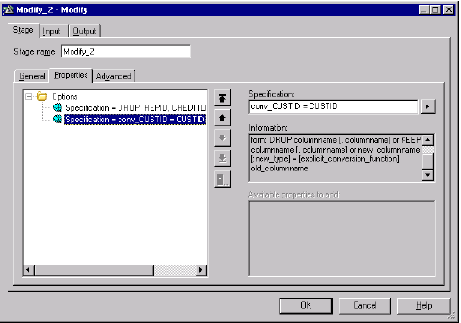
Modify Stage : Stage Properties
Multiple specifications can be entered. Each will be carried out sequentially
Enter the operation required in ‘Specifications’ field. eg DROP <column name>
Any use, copying or distribution without written permission from UnitedHealth Group is prohibited.

Slide 23
Module Objectives
At the end of this module you will be able to:
  Use the Filter Stage to route rows to different output links
  Describe the different properties available with Filter Stage
Any use, copying or distribution without written permission from UnitedHealth Group is prohibited.

Slide 24

Switch Stage
The switch stage takes a single data set as input and assigns each input row to an output data set based on the value of a selector field.
The Switch stage performs an operation analogous to a C switch statement, which causes the flow of control in a C program to branch to one of several cases based on the value of a selector variable.
Rows that satisfy none of the cases are output on the rejects link.
It can have a single input link, up to 128 output links and a single rejects link.

Slide 25
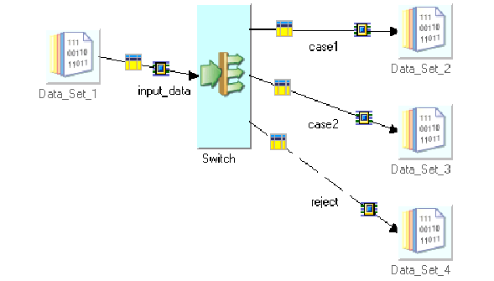
Switch Stage Usage

Slide 26
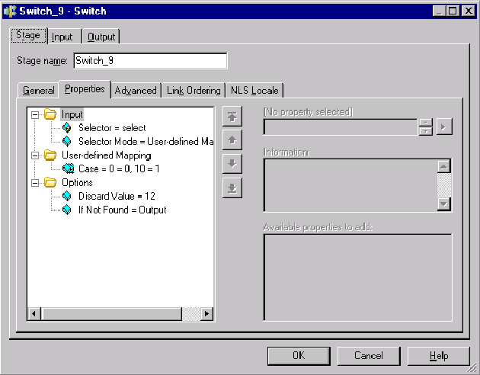
Switch Stage UI
switch (selector)
{
case 0: // if selector = 0,
// write record to output data set 0
break;
case 10: // if selector = 10,
// write record to output data set 1
break;
case 12: // if selector = discard value (12)
// skip record
break;
case default: // if selector is invalid,
// send row down reject link
};

Slide 27
Switch Stage – Options
Case: This property appears if you have chosen a Selector Mode of Userdefined Mapping. Specify the case expression in the case property. It has the following format:
Selector_Value[= Output_Link_Label_Number]
You must specify a selector value for each value of the input column that you want to direct to an output column. Repeat the Case property to specify multiple values. You can omit the output link label if the value is intended for the same output link as the case previously specified.
For example, the case statements shown would cause the rows containing the dates 1990, 1991, or 1992 in the selector column to be routed to output link 0, and the rows containing the dates 1993 to 1994 to be routed to output link 1.
E.g.
1990=0
1991
1992
1993=1
1994=1

Slide 28

Pivot Stage :
Pivot Stage converts columns in to rows.
Eg., Mark-1 and Mark-2 are two columns.
Task : Convert all the columns in to one column.
Implication : Can be used to co SCD Type-3 to Type-2.
Using Methodology : In the deviation field of the output column change the input columns in to one column.
Eg., Column Name – "Marks".
Derivation : Mark-1 and Mark-2.
Note : Column "Marks" is derived from the input columns Mark-1 and Mark-2.

Slide 29

Job (before execution):

Slide 30
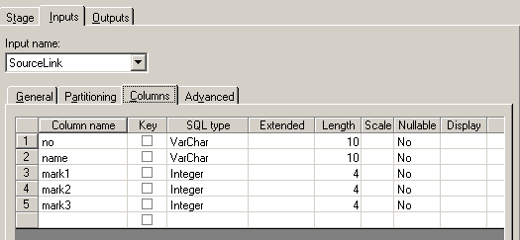

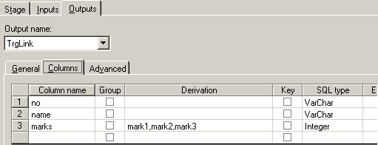
Input metadata:
Source File:
Output Metadata:
Note the change in the derivation …

Slide 31

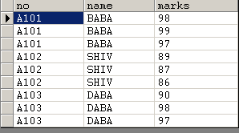
Job (after execution) :
Output file:

Slide 32
Combining Data
There are two ways to combine data:
  Horizontally:
  Several input links; one output link (+ optional rejects) made of columns from different input links. E.g.,
    Joins
    Lookup
    Merge
  Vertically:
  One input link, one output link with column combining values from all input rows. E.g.,
    Aggregator

Slide 33
Join, Lookup & Merge Stages
These "three Stages" combine two or more input links according to values of user-designated "key" column(s).
They differ mainly in:
  Memory usage
  Treatment of rows with unmatched key values
  Input requirements (sorted, de-duplicated)

Slide 34
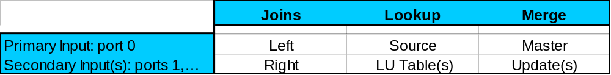
Not all Links are Created Equal
Enterprise Edition distinguishes between:
  - The Primary Input (Framework port 0)
  - Secondary - in some cases "Reference" (other ports)
Naming convention:
Tip:
Check "Input Ordering" tab to make sure intended Primary is listed first
Notes:
The Framework concept of Port # is translated in the GUI by Primary/Reference

Slide 35
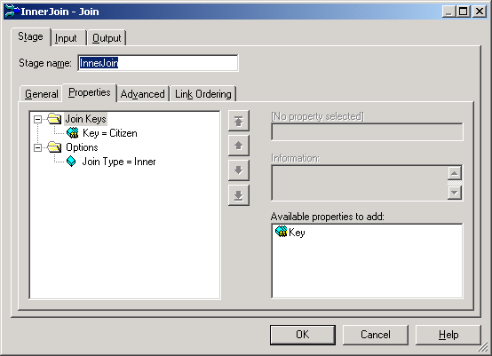
Join Stage Editor
Link Order immaterial for Inner and Full Outer Joins (but VERY important for Left/Right Outer and Lookup and Merge)
One of four variants:
  Inner
  Left Outer
  Right Outer
  Full Outer
Several key columns allowed

Slide 36

1. The Join Stage
Inner
Left Outer
Right Outer
Full Outer
Four types:
2 sorted input links, 1 output link
  "left outer" on primary input, "right outer" on secondary input
  Pre-sort make joins "lightweight": few rows need to be in RAM
Notes:
Follow the RDBMS-style relational model: the operations Join and Load in RDBMS commute.
x-products in case of duplicates, matching entries are reusable
No fail/reject/drop option for missed matches

Slide 37

2. The Lookup Stage
Combines:
  one source link with
  one or more duplicate-free table links
Source
input
One or more tables (LUTs)
no pre-sort necessary
allows multiple keys LUTs
flexible exception handling for
source input rows with no match
0
1
2
0
1
Lookup
Output
Reject
Notes:
Contrary to Join, Lookup and Merge deal with missing rows.
Obviously, a missing row cannot be captured, since it is missing. The closest thing one can capture is the corresponding unmatched row.
Lookup can capture in a reject link unmatched rows from the primary input(Source). That is why it has only one reject link (there is only one primary).
We'll see the reject option is exactly the opposite with the Merge stage.

Slide 38
The Lookup Stage
Lookup Tables should be small enough to fit into physical memory (otherwise, performance hit due to paging)
On an MPP you should partition the lookup tables using entire partitioning method, or partition them the same way you partition the source link
On an SMP, no physical duplication of a Lookup Table occurs

Slide 39
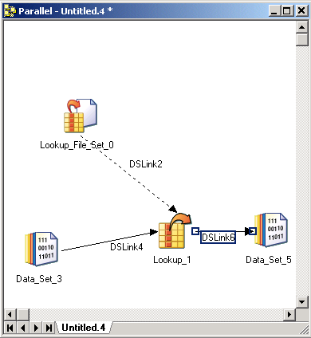
The Lookup Stage
Lookup File Set
  Like a persistent data set only it contains metadata about the key.
  Useful for staging lookup tables
RDBMS LOOKUP
  NORMAL
    Loads to an in memory hash table first
  SPARSE
    Select for each row.
    Might become a performance bottleneck.

Slide 40

3. The Merge Stage
Combines
  one sorted, duplicate-free master (primary) link with
  one or more sorted update (secondary) links.
  Pre-sort makes merge "lightweight": few rows need to be in RAM (as with joins, but opposite to lookup).
Follows the Master-Update model:
  Master row and one or more updates row are merged if they have the same value in user-specified key column(s).
  A non-key column occurs in several inputs? The lowest input port number prevails (e.g., master over update; update values are ignored)
  Unmatched ("Bad") master rows can be either
    kept
    dropped
  Unmatched ("Bad") update rows in input link can be captured in a "reject" link
  Matched update rows are consumed.

Slide 41
The Merge Stage
Allows composite keys
Multiple update links
Matched update rows are consumed
Unmatched updates can be captured
Lightweight
Space/time tradeoff: presorts vs. in-RAM table
Master
One or more updates
0
1
2
0
1
2
Merge
Output
Rejects
Notes:
Contrary to Lookup, Merges captures unmatched secondary (update) rows. Since there may be several update links, there may be several reject links.

Slide 42
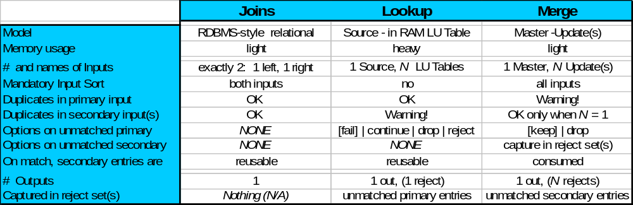
Joins, Lookup, & Merge
In this table:
, <comma> = separator between primary and secondary input links
(out and reject links)
Notes:
This table contains everything one needs to know to use the three stages.

Slide 43
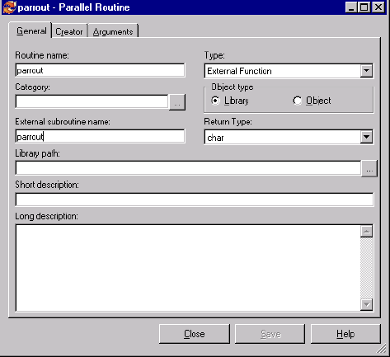
Creating a Parallel Routine
To create a new routine, select the Routines branch in the DataStage
Manager window and do one of the following:
Choose File ➤ New Parallel Routine… .
Select New Parallel Routine… from the shortcut menu.
The pathname should be the exact name of the library or object file.
If you have specified the Object option, enter the pathname of the
object file. Typically the file will be suffixed with .o. This file must exist and be a valid object file for the linker.

